Slide 1

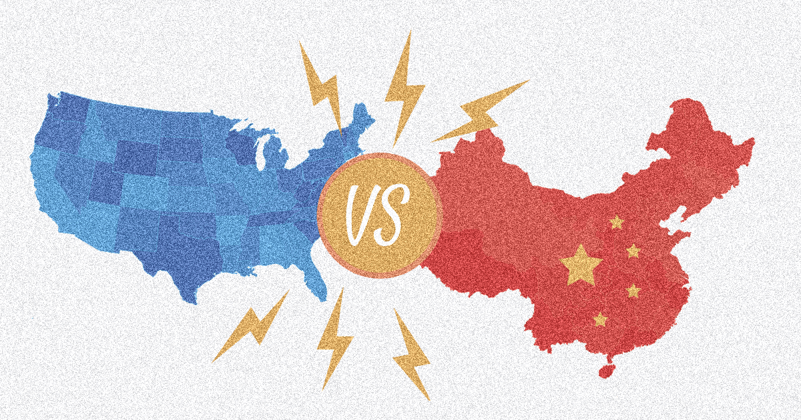
Knowledge Graph Based on the Impact
of Trade War on Electronic Industry
Team A9
Presenter MEI Yudong
NIU Yuke, YUAN Wengao, ZHU Xin, Zhang Yanling, Zou Xuyuan

Slide 2
Introduction
Background
The China–United States trade war is an ongoing economic conflict between the world's two largest national economies.
The electronic industry , such as Huawei and ZTE, bore the bunt of trade war.
Objective
Our goal is to find the impacts of the trade war on the electronic industry of China with up-to-date social media analytic techniques.
Data Source
South China Morning Post: https://www.scmp.com/

Slide 3
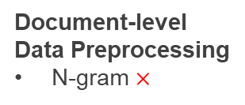
Guideline
Web Scrapping
Fiddler
Optimized requests
JSON
MySQL Server
Document-level
Data Preprocessing
N-gram $×$
Key words mining
Topic mining
GMM clustering
1
2
3
4
5
6
Sentence-level Preprocessing
Removing HTML tag
Lowering the case
Transforming proper nouns
Stemming and lemmatization
Removing stopwords
Expending simplified expression
Removing punctuation
Vectorization
Descreted TF-IDF
Word2Vec
Knowledge Graph
Inference
Search engine
Visualization

Slide 4
Web Scraping
Trade war
chip
Huawei

Slide 5
Data Preprocessing
MainDf
Remove HTML tag, stopwords, punctuations
Transforming proper nouns, stemming and lemmatization
Sentence-Level Preprocessing
Expand simplified expression
Tokenization of sentence
Document-level
Preprocessing
Tokenization of word
Descreted Tfidf
Vectorization
N-gram ×
Word2Vec
Data are logarithmically transformed and outliers are excluded
Tensor Data

Slide 6
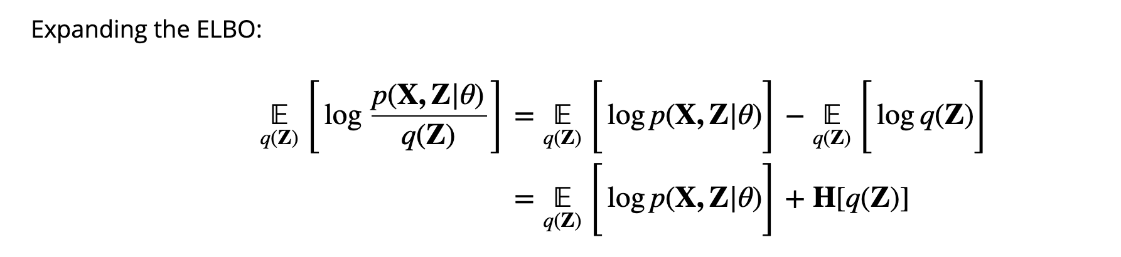
Topic Mining——Filter Nouns
Method: Latent Dirichlet Allocation (LDA)
E-step
Topic-1 | Topic-2 | Topic-3 | Topic-4 | Topic-5
energyefficiency | merge | nan | people | las
watts | exports | music | way | handsets
currentaccount | per | exhibition | get | vegas
volts | china | theatre | long | server
citigroup | cent | dance | work | ces
speciality | global | hall | city | daimler
fiveg | policy | harbour | think | sedan
disparities | trade | st | every | segments
upheavals | last | film | want | electriccar
palo | would | rd | party | brain
jealousy | market | featuring | political | touching
membrane | new | gf | go | highperformance
holistically | companies | contemporary | home | shanghais
branko | first | inquiries | never | iot
nave | billion | perform | university | nevada
M-step
Ranked LDA (part)
Topic-1& 5: influence on high tech
Topic-3: influence on lives of people
Topic-2: influence on the international society
Topic-4: influence on the internal society
Keep The same length of 1918 words

Slide 7
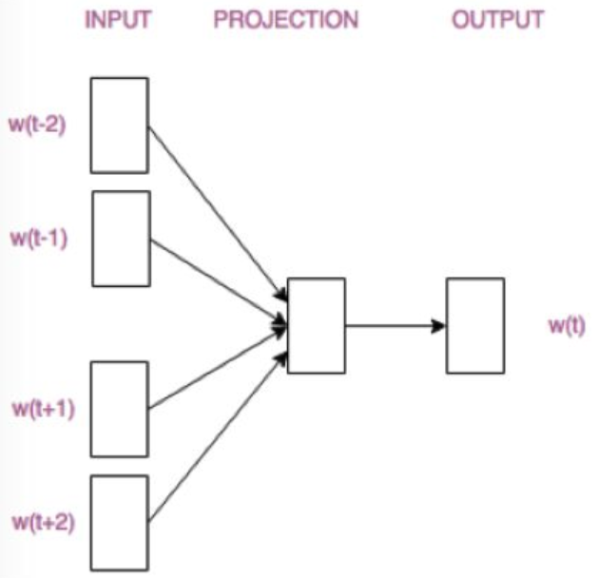
Event Clustering——Filter Verbs
Australia Don't meddle in America's own affairs China has slammed the US because President Barack Obama met the Dalai Lama
[('Australia', 'N'), ("Don't", 'N'), ('meddle', 'V'), ('in', 'I'), ("America's", 'N'), ('own', 'J'), ('affairs', 'N'), ('China', 'N'), ('has', 'V'), ('slammed', 'V'), ('the', 'D'), ('US', 'N'), ('because', 'I'), ('President', 'N')]
[('Australia', 'N'), ("Don't", 'N'), ('meddle', 'V'), ("America's", 'N'), ('affairs', 'N'), ('China', 'N'), ('has', 'V'), ('slammed', 'V'), ('US', 'N'), ('President', 'N')]
[("Don't", 'N'), ('meddle', 'V'), ('China', 'N'), ('slammed', 'V'), ('President', 'N')]
GMM Cluster
Business Action (27%)
Australia
~
National Strategies (22%)
Don't
meddle
Technology (32%)
America's
affairs
Financial Behavior (19%)

Slide 8
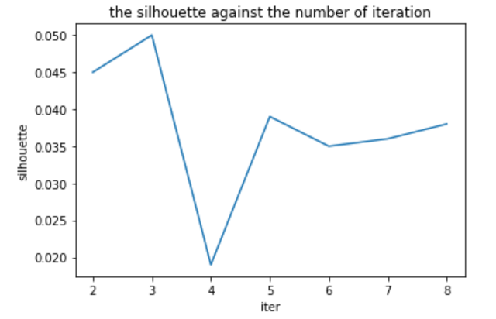

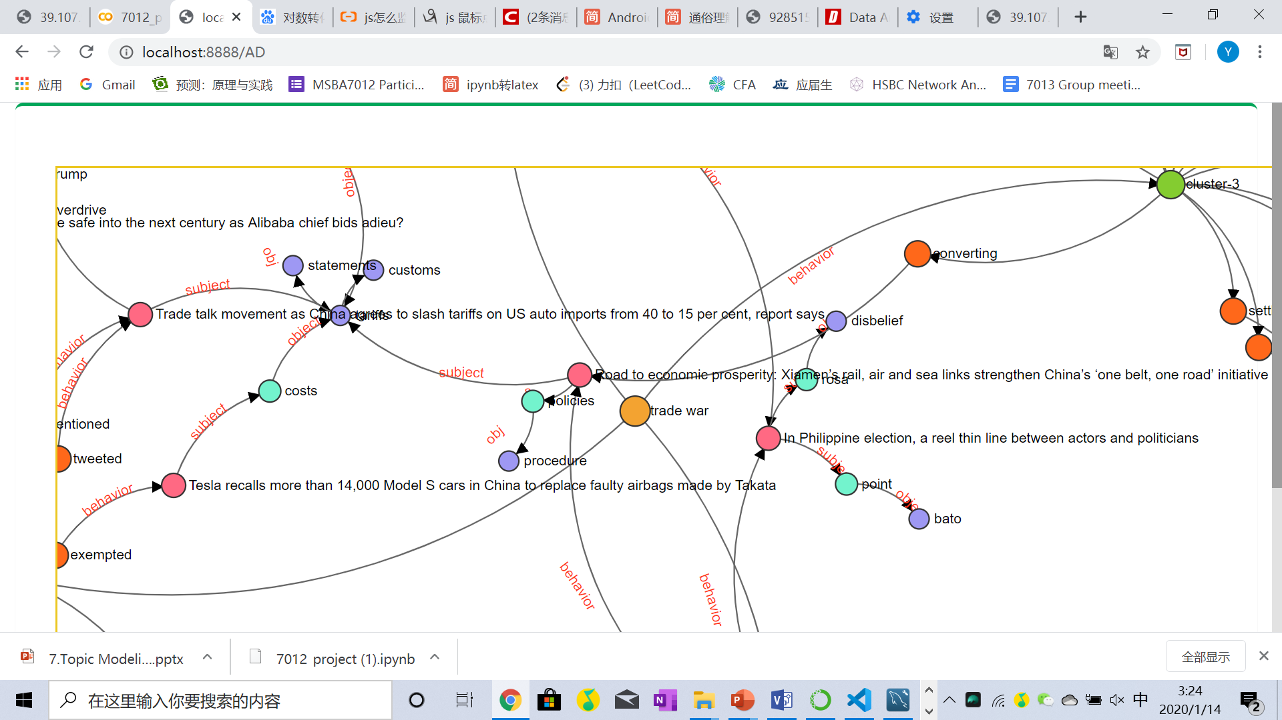
Knowledge Graph Inference
LDA
Noun
GMM Cluster
Verb
C
V
N
S
O
Australia (S) Don't meddle (V) in America's own affairs China (O)(S) has slammed (V) the US because President (O) Barack Obama met the Dalai Lama
O
News
Australia
China
N
S
S
News
N
meddle
slammed
President
DEMO of KG of 30 sentences
V
V
O

Slide 9
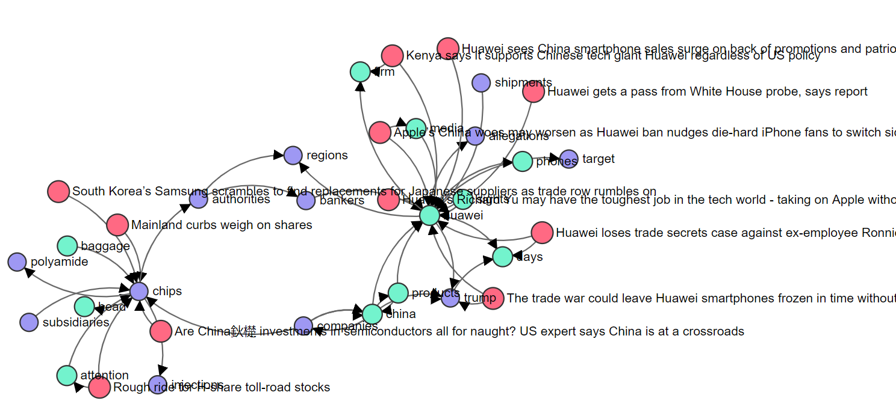
Knowledge Graph Search Results
http://39.107.92.174:8888/AD?kw=huawei%20chips
chips -> authority -> region -> banks -> Huawei -> phones -> apple
The innovative chip, checked by corresponding authorities, provides a platform for Huawei to adapt itself to both IOS (Apple) and Android together, which is the main job of Richard Yu recently, which might be an intervention to the market of smartphones. The investment banks’ suggest to investing to electronic stock can also reflect the situation

Slide 10
Conclusion and Suggestion
Jaccard similarity and cosine similarity are both utilized in calculating the distance between words, which smooths the function of the KG significantly; Most famous events are correlated reasonably but not all the connections are perfect;
The event abstracting method or pattern is too simple, which is to be upgraded with new technology such as NER, multiple-task learning model and so on;
The data and model have been mapped out on the server of 39.107.92.174 with Tornado and MySQL. Feel free to enjoy it.
Business Applications
Knowledge Graphs make data smart by processing information in a human-like way. A company of electronic industry could directly find its position from the KG and dig out the underlying pattern of how the company was impacted by trade war, hence to avoid potential risks from trade war.
Our KG also provides valuable information and logic for research on historic events, international relationship, supply chain, and so on.

Slide 11
THANK YOU
FOR ATTENTION

